Slide 1
Basic Computer Organization
Muhammad Afzaal
m.afzaal@nu.edu.pk

Slide 2
Book Chapter
“Assembly Language for x86 processors”
Author “Kip R. Irvine”
6th Edition
Chapter 2
Section 2.1

Slide 3
Organization and Architecture
Computer Architecture
Attributes of a computer that have a direct impact on the logical program execution
e.g. I/O mechanisms, memory addressing techniques
Computer Organization
Operational units and their interconnection that realizes the architectural specifications
e.g. control signals, interconnection between computer and its peripherals

Slide 4
Basic Computer Organization (1/2)
Computer has 3 main components
Processor, also called Central Processing Unit (CPU)
Memory and Storage Devices
I/O Devices
These components communicate with each other through
Data Bus
I/O Bus
Address Bus
Control Bus

Slide 5
Basic Computer Organization (2/2)
I/O Bus
Data Bus
Registers
Memory Storage Unit
I/O Device #1
I/O Device #2
Central
Processing Unit
(CPU)
ALU | CU | CLOCK
Control Bus
Address Bus

Slide 6
Central Processing Unit (CPU)
Generally called Processor
Contains
Clock
Registers
Arithmetic Logic Unit (ALU)
Performs arithmetic and logic instructions
Control Unit (CU)
Generates the control signals required to execute the instructions

Slide 7
Clock (1/2)
Clock cycle is basic unit of time for machine instructions
Synchronizes Processor and Bus operations
Clock cycle = Clock period = 1/(Clock Rate)
Clock Rate = Clock Frequency = Cycles per sec
1 Hz clock produces 1 Clock Cycle in 1 second
1 KHz clock produces 1000 Clock Cycles in 1 second
1 MHz clock produces 1,000,000 cycles in 1 second
1 GHz clock produces 1,000,000,000 cycles in 1 second

Slide 8
Clock (2/2)
One Cycle
1
0
Clock Frequency | Clock Period (sec) | Time to execute one instruction
1 Hz | 1 | 1 sec
1 KHz | 0.001 | 1 ms (millisecond)
1 MHz | 0.000,001 | 1 μs (microsecond)
1 GHz | 0.000,000,001 | 1 ns (nanosecond)

Slide 9
Memory (1/2)
Ordered sequence of bytes
Sequence number is called memory address
Byte addressable memory
Each byte has a unique address
Physical address space
Determined by the address bus width
Pentium has 32-bit address bus
Physical address space of Pentium = 2³² bytes = 4 GB
Itanium with 64-bit address bus can support up to 2⁶⁴ bytes of physical address space

Slide 10
Memory (2/2)
Address of location to be read/written is placed on the address bus
Data to be read/written is places on the data bus by memory/processor
Two control signals read and write decide the reading or writing operations
Memory Unit
Address
Data
Read
Write

Slide 11
Physical Address Space
Address space is the set of addressable memory locations (bytes)
Address
in decimal
Address
in hex
2³²-1
FFFFFFFF
FFFFFFFE
FFFFFFFD
2
00000002
1
00000001
0
00000000

Slide 12
Reading from Memory
Multiple clock cycles are required
Memory responds much more slowly than CPU
Reading process is carried out in this way
Address is placed on the address bus
Read Line (RL) goes low indicating that processor wants to read
CPU waits for memory to respond
Read Line (RL) goes high indicating that data has been placed on the data bus

Slide 13
Memory Read and Write Cycles
In Read Cycle, the Processor
places address on address bus
asserts the memory read control signal
waits for memory to place data on the data bus
reads the data from data bus
drops the memory read signal
In Write Cycle, the Processor
places address on the address bus
asserts the memory write control signal
places the data on the data bus
waits for memory to store the data
drops the memory write signal

Slide 14
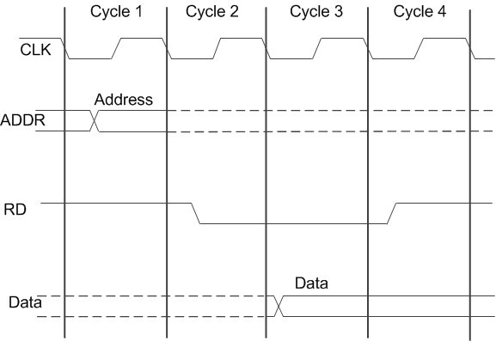
Reading from Memory

Slide 15
Memory Hierarchy
Registers
Fastest storage elements
Cache Memory
Stores recently used instructions
Main Memory
Magnetic Disk
Stores data permanently
Magnetic Tape
Regis-ters
Inboard
Storage
Cache
Higher Speed, Smaller Size
Lower cost per Byte
Main Memory
Magnetic Disk
CD-ROM
CD-RW
DVD-RW
Outboard
Storage
Off-line Storage
Magnetic Tape

Slide 16
Next Lecture
IA-32 Registers
General Purpose Registers
Special-Purpose and Segment Registers
EFLAGS Registers

